Slide 1

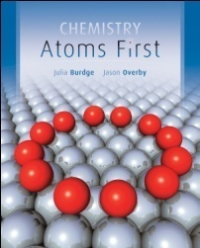
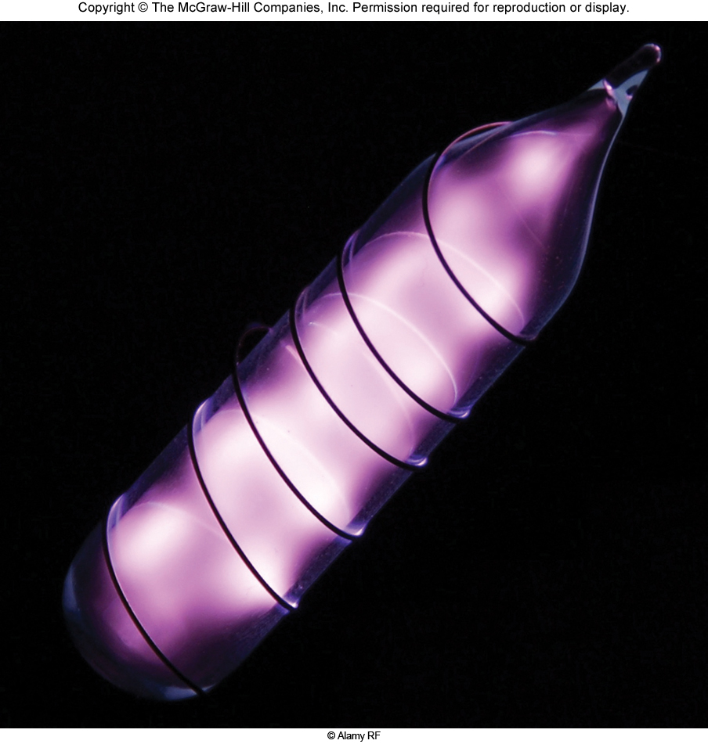

Chemistry: Atoms First
Julia Burdge & Jason Overby
Chapter 2
Atoms and the
Periodic Table
Kent L. McCorkle
Cosumnes River College
Sacramento, CA
Copyright (c) The McGraw-Hill Companies, Inc. Permission required for reproduction or display.
Copyright (c) The McGraw-Hill Companies, Inc. Permission required for reproduction or display.

Slide 2

Atoms and the Periodic Table
2
2.1 Atoms First
2.2 Subatomic Particles and Atomic Structure
Discovery of the Electron
Radioactivity
The Proton and the Nuclear Model of the Atom
The Neutron
2.3 Atomic Number, Mass Number, and Isotopes
2.4 Average Atomic Mass
2.5 The Periodic Table
2.6 The Mole and Molar Mass
The Mole
Molar Mass
Interconverting Mass, Moles, and Numbers of Atoms

Slide 3
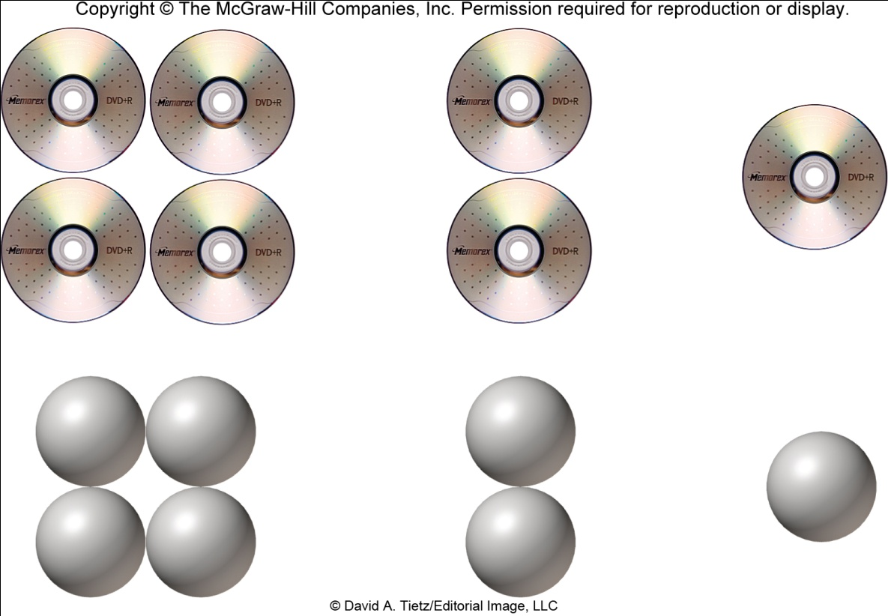
Atoms First
2.1
Atom: the smallest quantity of matter that still retains its properties
Element: a substance that can’t be broken down into multiple substances by any means
Elements: oxygen (O₂), nitrogen (N₂), copper (Cu)
Not elements: air (can be separated into different gases, including N₂ and O₂)
alloy (e.g., bronze can be separated into Cu, Sn, and other metals)
A CD set can be separated into smaller parts until one CD is left.
A single CD cannot be broken into smaller pieces that are still CDs.
Matter can likewise be divided smaller and smaller until a single atom remains.
Dividing further yields pieces (subatomic particles) with
very different properties

Slide 4
Atoms First
The nature, number, and arrangement of subatomic particles determine the properties of atoms,
which then determine the properties of all material objects

Slide 5
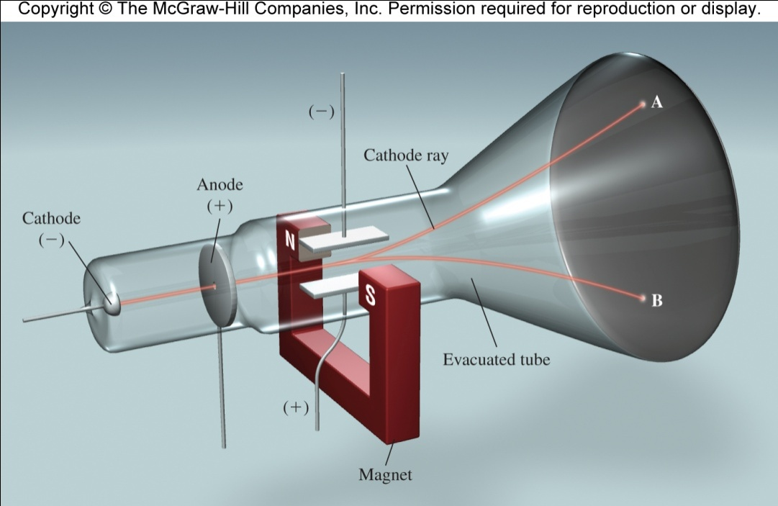
Subatomic Particles and Atomic Structure
2.2
In the late 1800’s, many scientists were doing research involving radiation –
the emission and transmission of energy in the form of waves.
They commonly used a cathode ray tube, which consists of two metal plates sealed inside a glass tube under vacuum
(meaning that most air has been evacuated).

Slide 6
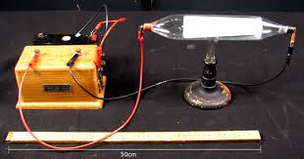
Subatomic Particles and Atomic Structure
Cathode rays (late 1800-s)
In vacuum, an electrode at high negative voltage emits invisible rays
that produce bright light when striking a fluorescent material
The cathode ray is drawn to the anode where it passes through a hole.
Path of the rays is revealed when the ray strikes a
phosphor-coated surface producing a bright light.

Slide 7
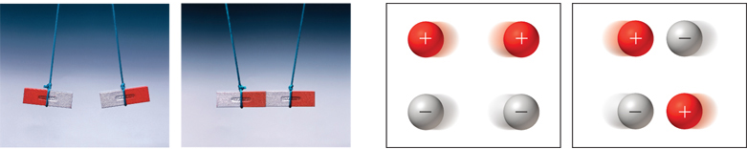
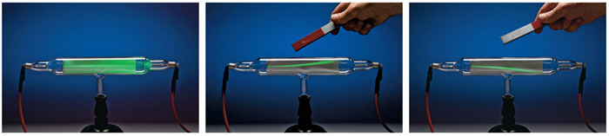
Subatomic Particles and Atomic Structure
Researches discovered that like charges repel each other, and opposite charges attract one another.
J. J. Thomson (1856 - 1940) noted the rays were repelled by a plate bearing a negative charge, and attracted to a plate bearing a positive charge.

Slide 8
Subatomic Particles and Atomic Structure
This prompted him to propose the rays were actually a stream of negatively charged particles.
These negatively charged particles are called electrons.
By varying the electric field and measuring the degree of deflection of cathode rays, Thomson determined the charge-to-mass ratio of electrons to be 1.76×10⁸ C/g.
(C is Coulomb, the derived SI unit of electric charge.)

Slide 9
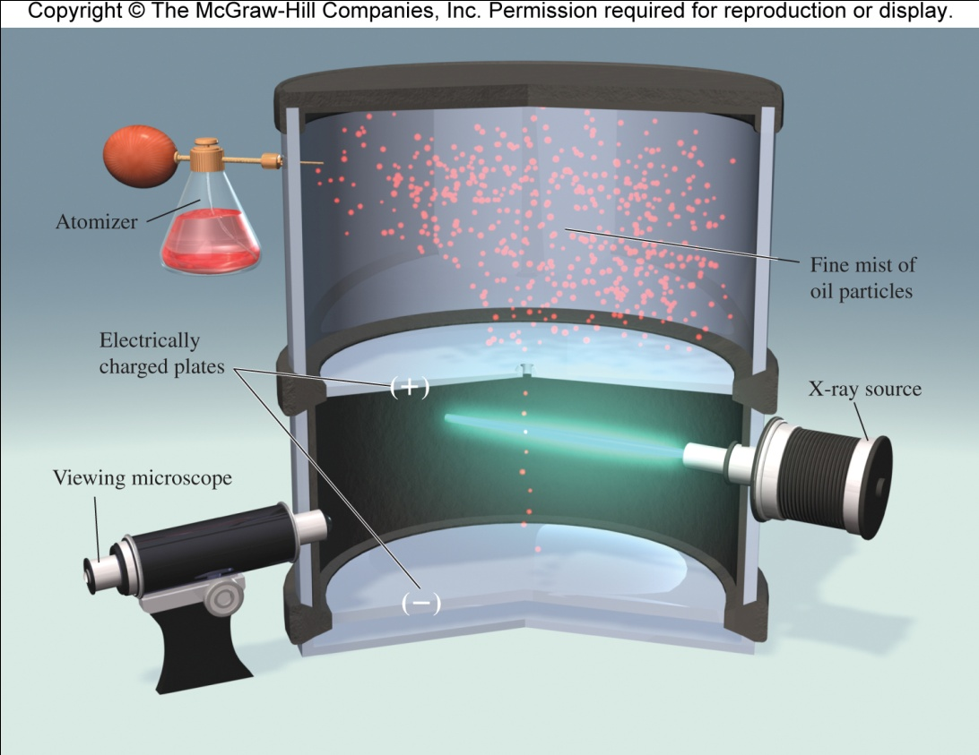
Subatomic Particles and Atomic Structure
R. A. Millikan (1868-1953) determined the charge on an electron by examining the motion of tiny oil drops.
The charge was determined to be -1.6022×10⁻¹⁹ C.

Slide 10

Subatomic Particles and Atomic Structure
Knowing the charge, he was then able to use Thomson’s charge-to-mass ratio to determine the mass of an electron.

Slide 11
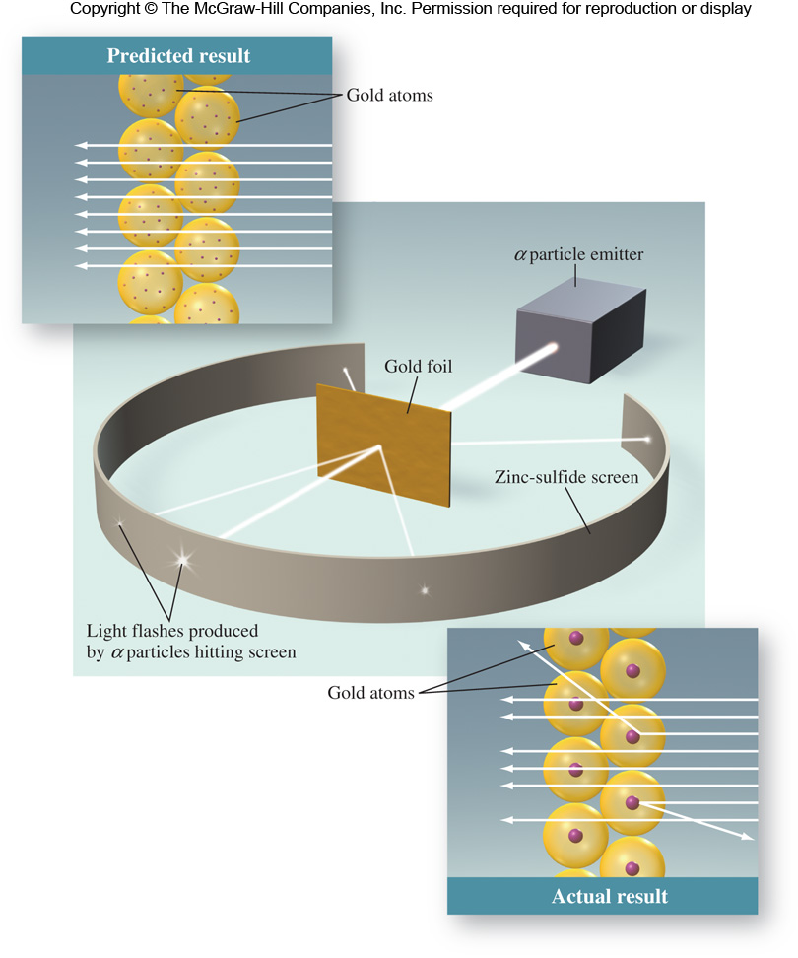
Subatomic Particles and Atomic Structure
Ernest Rutherford used α particles to prove the structure of atoms.
The majority of particles penetrated the gold foil undeflected.
Sometimes, α particles were deflected at a large angle.
Sometimes, α particles bounced back in the direction from which they had come.

Slide 12
Subatomic Particles and Atomic Structure
Rutherford proposed a new model for the atom:
Positive charge is concentrated in the nucleus.
The nucleus accounts for most of an atom’s mass and is an extremely dense central core within the atom.
A typical atomic radius is about 100 pm
A typical nucleus has a radius of about 5×10^{–3} pm
1 pm = 1×10^{–12} m

Slide 13
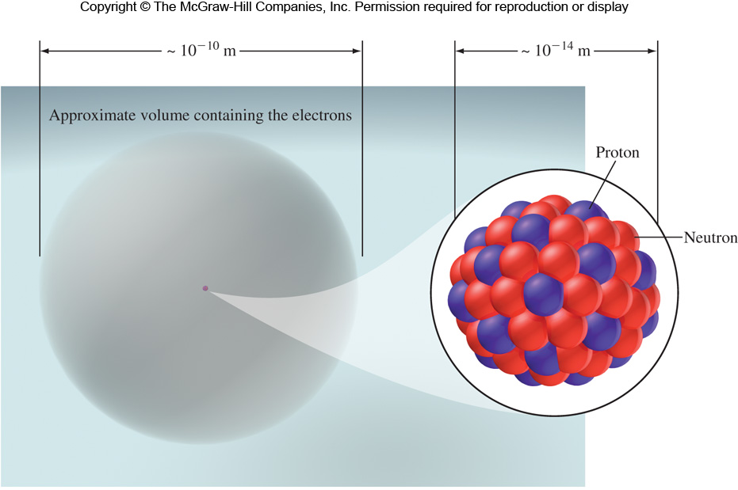
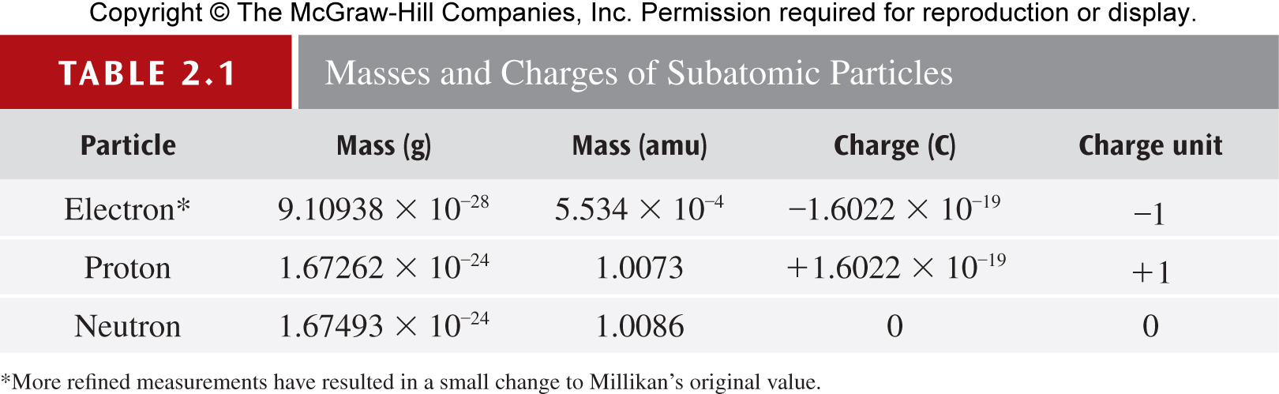
Subatomic Particles and Atomic Structure
Protons are positively charged particles found in the nucleus
Neutrons are electrically neutral particles found in the nucleus - slightly heavier than protons

